Slide 1

Sales Performance Analysis

Slide 2



Team
Amira Maged Farahat
Fatma Saeed Abdelwanes
Ahmed Adel Sayed
Ahmed Gamal Sobhy
Walaa Sayed Morsy

Slide 3

Agenda
What this report will cover
Introduction
Company Profile
Sales Performance Insights
Customer Segmentation
Profitability Analysis
Geographical InsightsI
Recommendations and Next Steps

Slide 4
Introduction

Slide 5

Objective of the Sales Project
The primary objective of this sales project is to analyze sales performance across various regions, product lines, and customer segments.
By leveraging data-driven insights,the goal is to identify trends, uncover potential growth opportunities, and optimize sales strategies to maximize profitability.

Slide 6
Business Problem
The business is facing a challenge in accurately tracking and understanding sales performance due to fragmented data across multiple sources.
This project addresses the need for a consolidated view of sales data, which will allow us to better identify underperforming regions, capitalize on high-demand products, and refine our customer targeting efforts to drive growth.

Slide 7
Company Profile

Slide 8
Selling Activities
01
02
03
04
05
COUNTRIES
Orders
Customers
Products
City
more Than 165 Country
More Than 25K orders
More Than 17K
in 3 Segment
(Consumer - Home Office - Corporate )
More Than 3K Products
More than 3600

Slide 9
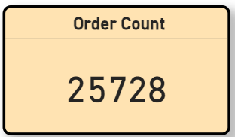
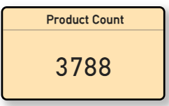
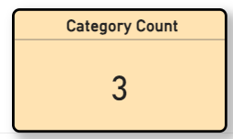
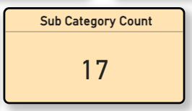
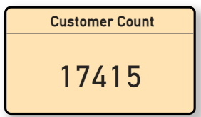
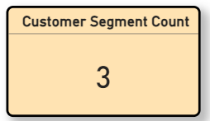
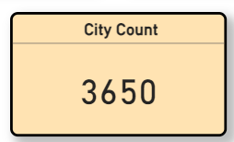
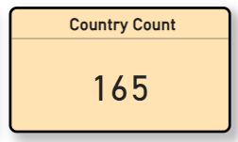

Slide 10
Sales Regions
23 Region
Total number of sales 12M
Westren europe is top region 1.7M
Top Country is France 850k

Slide 11
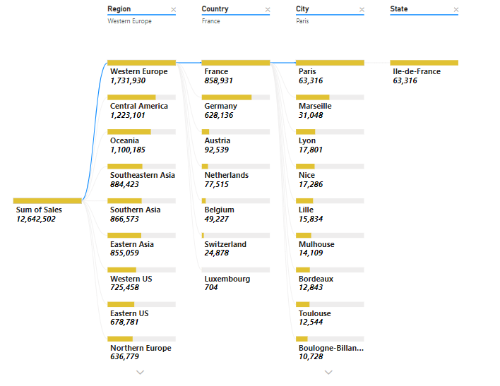
Sales by Region

Slide 12
Sales Performance Insights

Slide 13
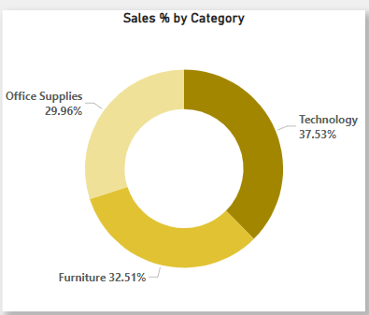
Sales
Leads
Sales lead by catogory
TECHNOLOGY SALES
4.7M

Slide 14
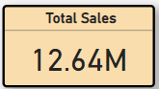
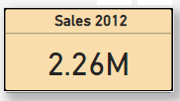
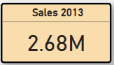
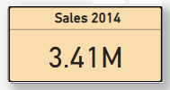
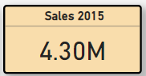
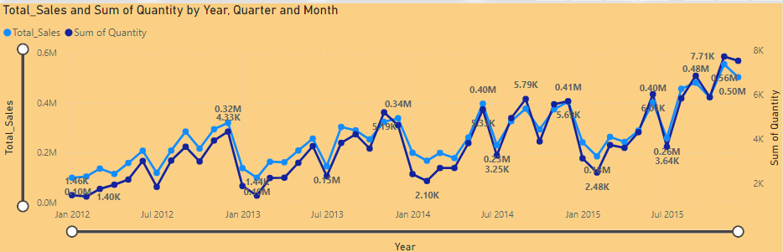
Overall Sales Performance

Slide 15
Customer Segmentation

Slide 16
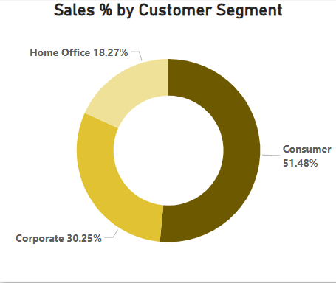
Customer Segmentation
Sales by coustomer segment
CONSUMER
SALES
PROFIT
6.5M
750K

Slide 17
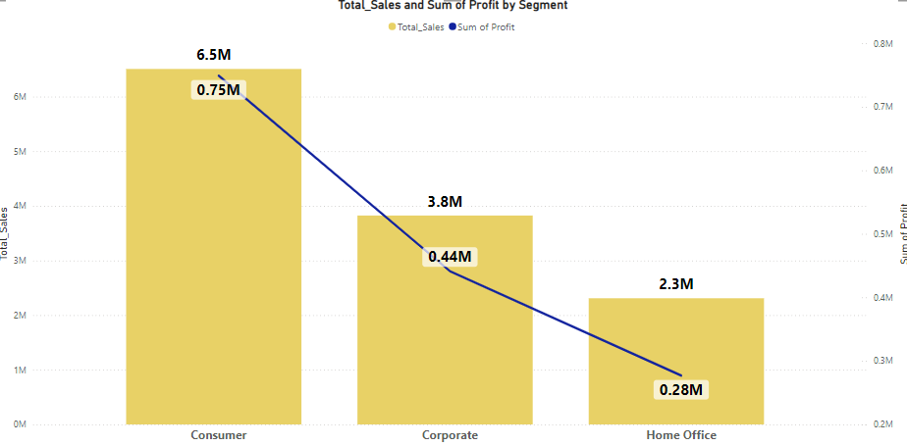
Breakdown of sales and profit by Customer Segment

Slide 18
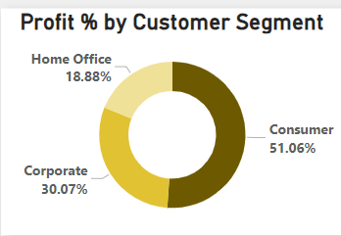
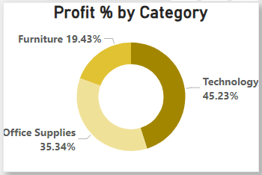
Profit Analysis
TOP CUSTOMETR SEGMENT
749K
TOP CATIGORY
CONSUMER
663K
TOP REGION
TECHNOLOGY
218K
WESTERN EUROPE

Slide 19
Geographical Insights

Slide 20
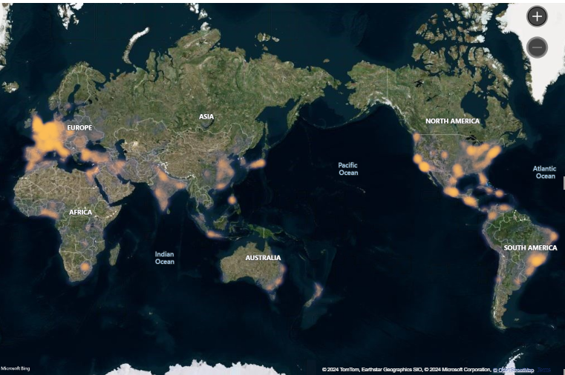
Sales by Region

Slide 21
Recommendations and Next Steps

Slide 22
01
Focus on High-Profit Areas
Recommendations and Next Steps
02
Address Low-Performance Markets
03
Enhance Profit Margins
04
Leverage Consumer Segments
05
Strengthen Product and Market Combinations
06
Leverage Dashboard and data modeling and KPI

Slide 23
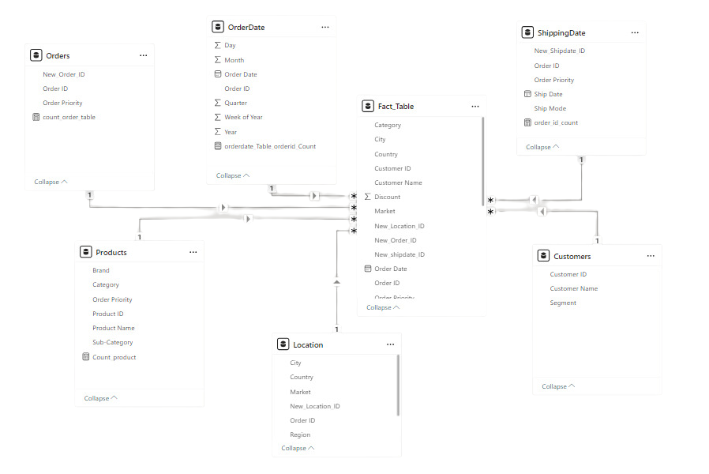
Data Modeling

Slide 24
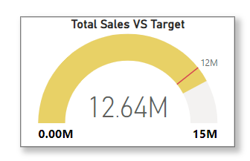
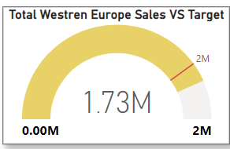
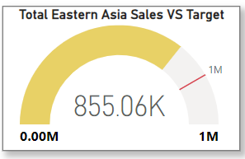
Sales KPI

Slide 25
Thank you!
Feel free to approach us if you have any questions.

